Slide 1
Machine Learning Driven Credit Risk Model
Notes:
TO ADD NEW SLIDE LAYOUTS: Make sure you have the ‘Home’ tab selected at the top of the PowerPoint screen and click the down facing arrow to the right on the ‘New Slide’ button that is located in the second section. Look through the layouts shown and click on the one you would like to work on.
TO REMOVE SLIDES: Select the slide you would like to remove in the vertical window on the left side of the screen then hit the ‘Delete’ (on Mac) or the ‘Backspace’ (on PC).
TO REMOVE PAGE NUMBERS: At the top of the PowerPoint screen between ‘Home’ and ‘Design’ click on ’Insert.’ Then in the options bar just below ’Insert’ click on ’Slide Number’ which is in the same section a the ‘Text Box’ and ‘Object.’ Uncheck the box next to ‘Slide Numbers’ and click ‘Apply to All.’
TO ADD PAGE NUMBERS: At the top of the PowerPoint screen between ‘Home’ and ‘Design’ click on ’Insert.’ Then in the options bar just below ’Insert’ click on ’Slide Number’ which is in the same section a the ‘Text Box’ and ‘Object.’ Check the box next to ‘Slide Numbers’ and click ‘Apply to All.’

Slide 2
Group Members
Chaithanya Etikala (700714120)
Pavani Reddy Ganga Saram (700734357)
Sai Surekha Gandu (700740324)
Vaishnavi Madiri (700735078)

Slide 3
Roles and Responsibilities
Data Acquisition and Visualization (Chaithanya (50%), Pavani(50%)
Data Pre-processing (Surekha)
Feature Engineering (Vaishnavi)
Model Training (all team members (25%))
Results and analysis (all team members (25%))

Slide 4
Contents
Introduction
Motivation
Objectives
Related Work
Problem Statement
Proposed Solutions
Results
References

Slide 5
Introduction
Financial institutions (Banks) are running into debts due to credit loans they offer.
Banks use credit risk analysis to ensure that loans are made to reliable customers.
CREDIT RISK :
The risk of default due to a borrower’s failure to timely make its required obligation payments.
Machine learning eliminates the need for tedious manual checks of various parameters and the conditions under which credit is granted.

Slide 6
Motivation
Lending institutions are plagued by bad loans that have increased over the years.
By employing machine learning, we can play a vital role in the credit market.
Previous data can help to predict the future analysis.
With the help of data, financial institutions can predict which customers may pose potential credit risks.

Slide 7
Objectives
Managing Risk for Financial Institution
Credit Risk and Customer Satisfaction
Fiduciary Responsibility
Reducing Decision Making Time

Slide 8
Related Works
Research has been done on various standard algorithms such as naïve bayes.
Many researchers have proposed various machine learning techniques
Jacky C. K. Chow applied PCA for dimensionality reduction to improve training and inference time

Slide 9
Problem Statement
Can risk be minimized ?
Will involving AI in loop reduce decision making time?
Can AI be precise enough to make financial decisions?
Which ML model can give good tradeoff in latency and metrics?

Slide 10
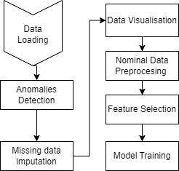
Proposed Solution
Data Pre-Processing (Missing values imputation)
Data Pre-Processing
Model training
Model Comparisons
Model Selection
Fig. 1. Experimental flow

Slide 11
Proposed Solution (1)
Training Models:
Logistic-Regression-Classifier
Naive Bayes-Classifier
Decision-Tree-Classifier
Random-Forest-Classifier
Ada-Boost-Classifier
LightGBM-Classifier
XGBoost-Classifier

Slide 12
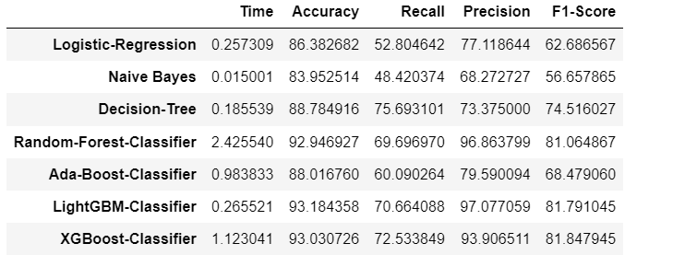
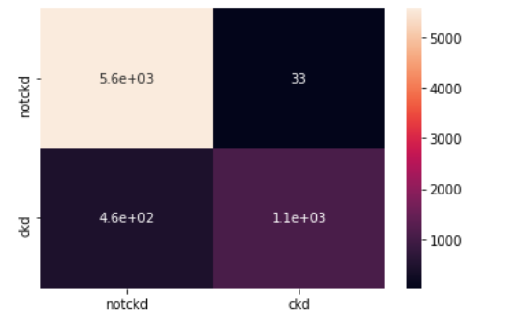
Results
Fig. 2. Overall Comparison of Training Models
Fig. 3. Confusion Matrix - LightGBM

Slide 13
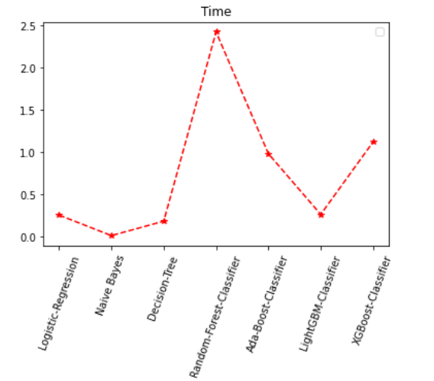
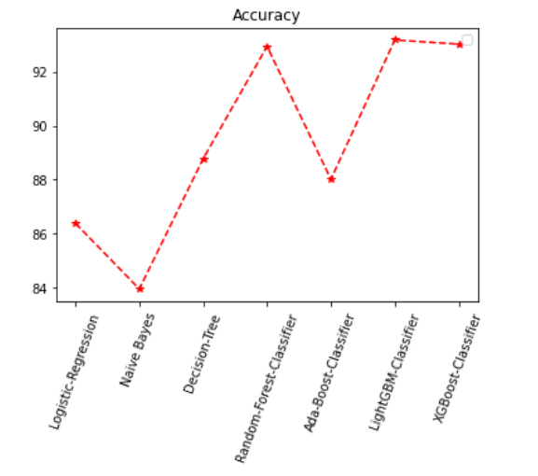
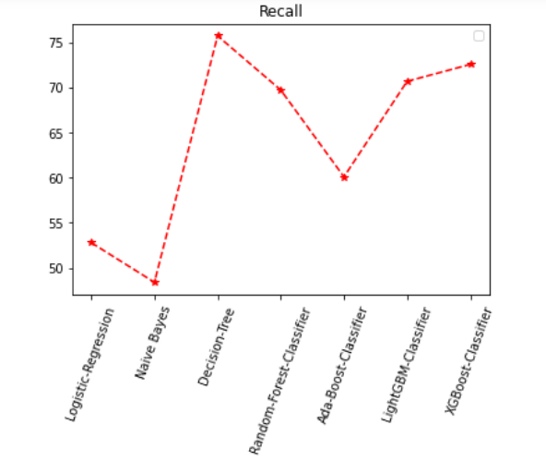
Results (1)
Fig. 4. Time plot Fig. 5. Accuracy Plot Fig. 6. Recall Plot

Slide 14
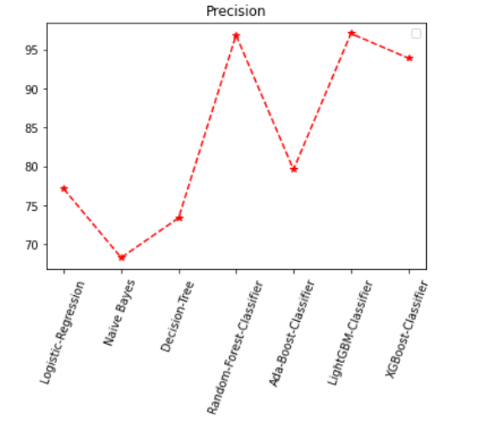
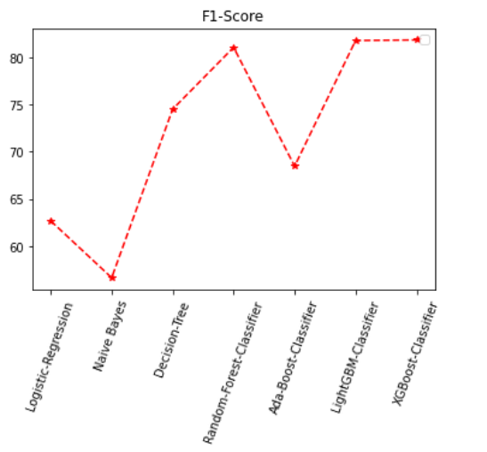
Results (2)
Fig. 7. Precision Plot Fig. 8. F1-Score

Slide 15
References
Shweta Arya, Catherine Eckel, and Colin Wichman. Anatomy of the credit score. Journal of Economic Behavior Organization, 95(4):175– 185, 2013.
Khandani, Amir E., Adlar J. Kim, and Andrew W. Lo. Consumer creditrisk models via machine-learning algorithms. Journal of Banking & Finance 34 (2010): 2767-2787.
Galindo, Jose´ Angel. Credit Risk Assessment Using Statistical and ´ Machine Learning: Basic Methodology and Risk Modeling Applications. Computational Economics - COMPUT ECON, 2000
DESAI, S V., CROOK, N J., J. R. Overstreet, and A G. A comparison of neural networks and linear scoring models in the credit union environment. European Journal of Operational Research, 95(1):24–37, 1996.
G Zhang, M Y. Hu, B Eddy Patuwo, and D C. Indro. Artificial neural networks in bankruptcy prediction: General framework and cross-validation analysis. European Journal of Operational Research, 116(1):16–32, 1999

Slide 16
Thank you!

